Slide 1
Time is Money: Time Series Forecasting
Group 54
Amy Lim Zhi Ting
Ang Kai Chao
Jerome Neo
Liao Tian Chang
Lye Jian Wen
Shriya Saxena

Slide 2
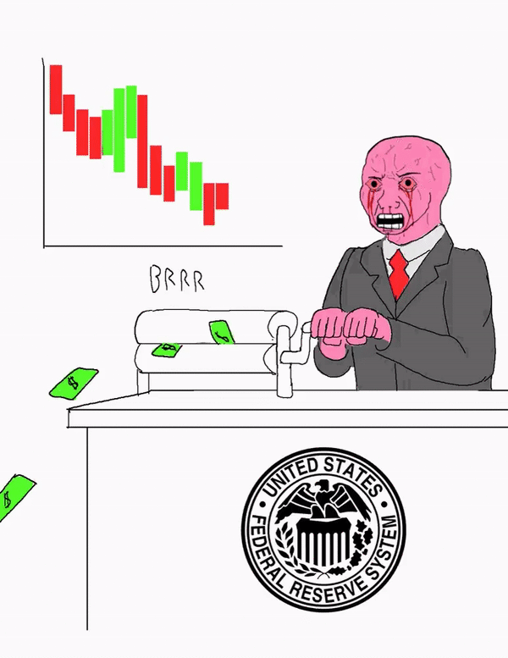
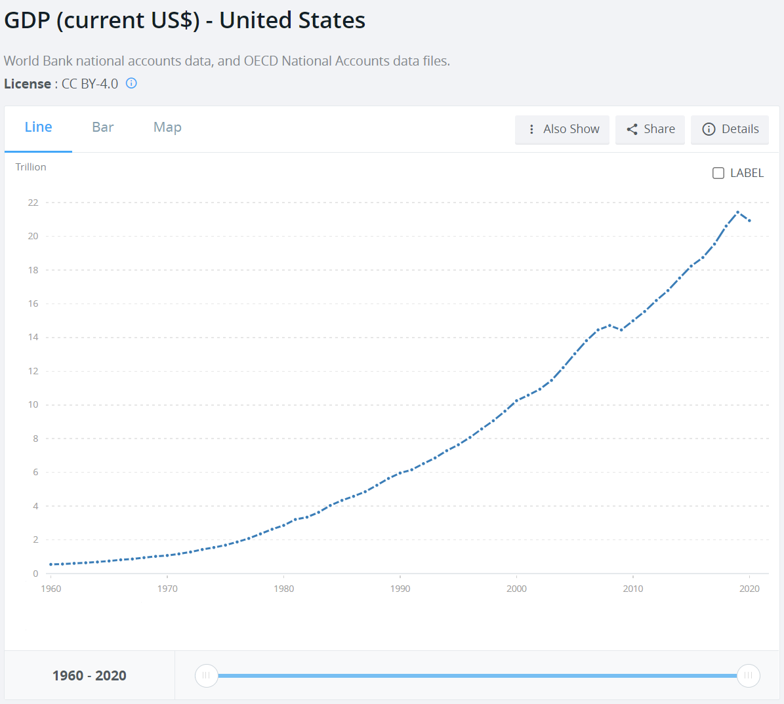
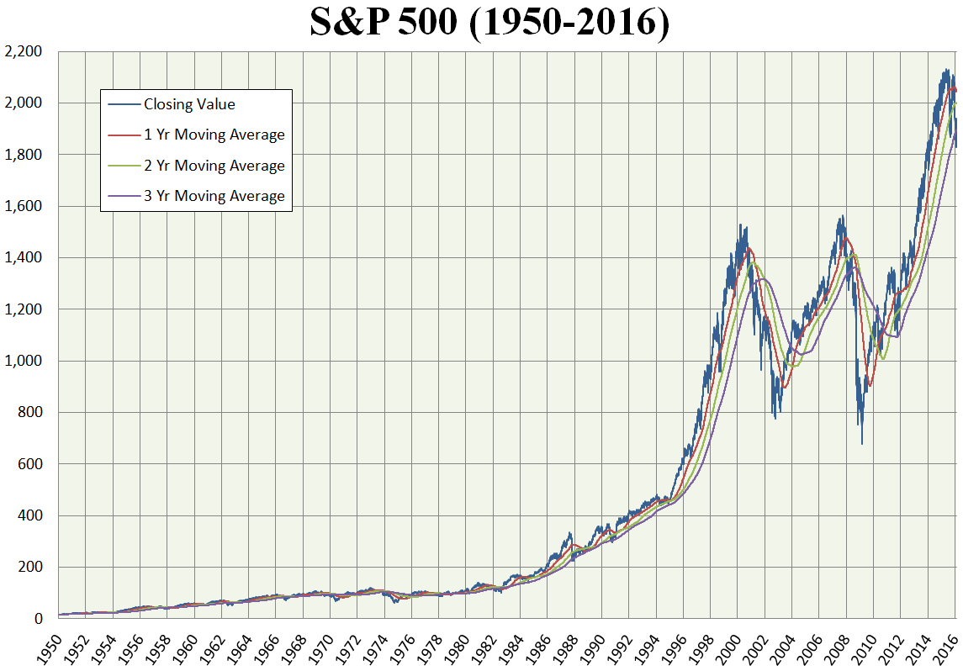
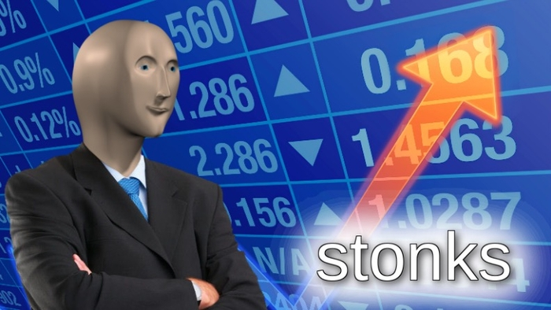
Stock Market Only Goes Up?

Slide 3
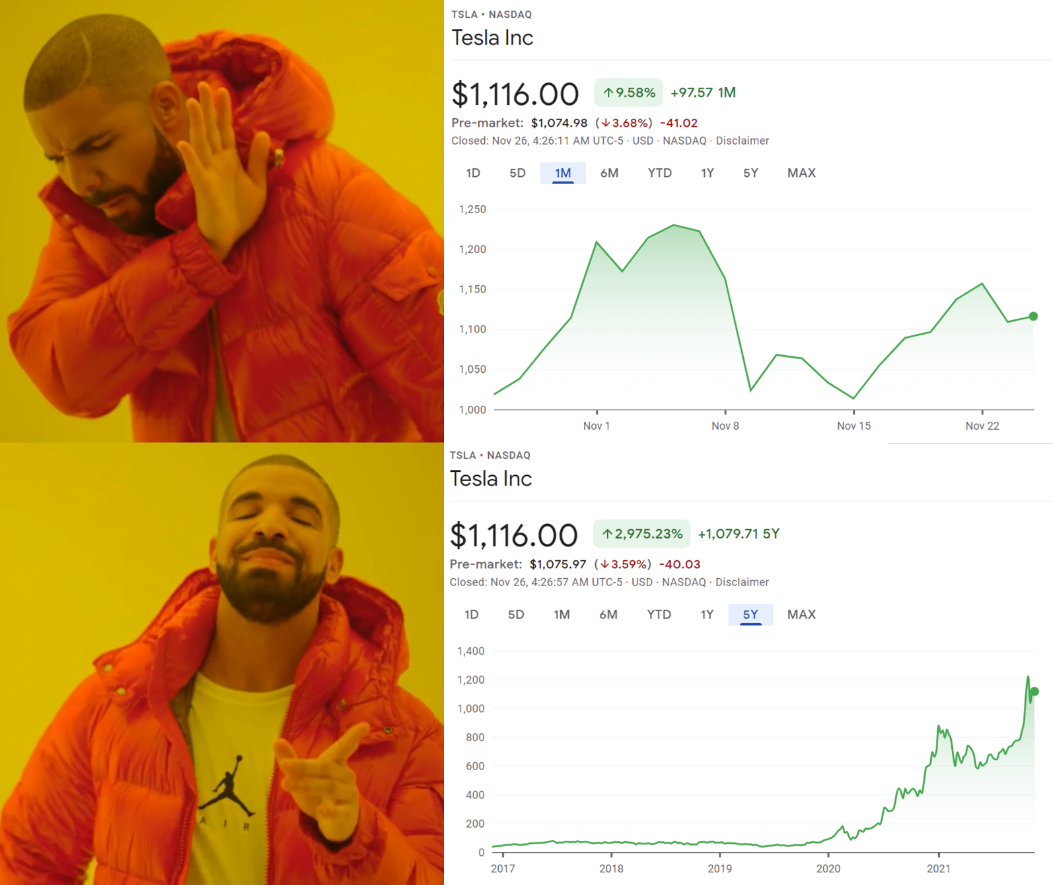
Given a sufficiently large timeframe, blue chip stocks are more likely to have an upward trend.
Should we trade in the longer timeframes to minimize risk? Does trading less frequently give slower but surer returns?

Slide 4
Can Machine Learning Help Optimize Trading?
Is there an optimal frequency to trade for hands-off traders?
How often should we sample the stock mprices for the modelling such that it makes the best predictions?
What modelling would work better for the stock market?

Slide 5

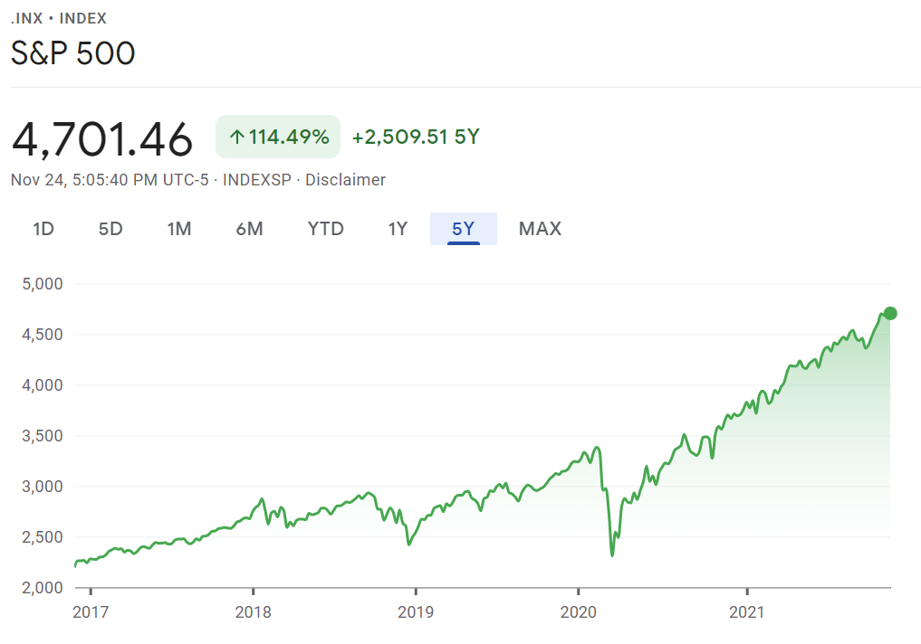
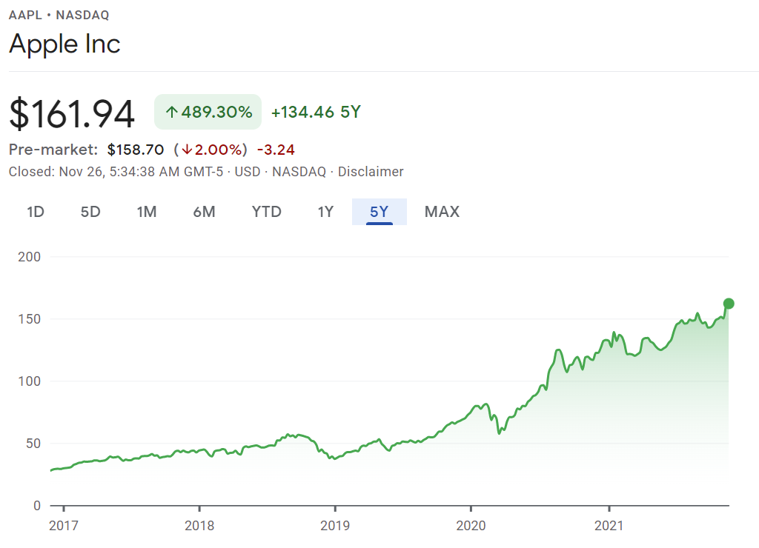
Let’s find a stock that tracks and outperforms the market
Apple Inc.
Tech industry leader
Component of most US market indices
Familiar company to us techies

Slide 6
How Do We Process the Raw Dataset?
Nature of dataset
Quarterly
4x
Time series: Series of data points in discretized time order
Even longer sampling period, only 4 datapoints a year
Monthly
20x
Increase sampling period by taking mean of all daily closing prices in a month
Daily
1x
We take the daily closing price of the stock as is. Every working day provides a datapoint
Timeframe
How regularly do we sample the stock prices?

Slide 7
How to Conduct the Comparison Fairly?
01
What span of time do the datapoints cover?
Time Period
Modelling with variable sampling rate
Is this fair?
For the same period of time, sampling less frequently gives less data points for modeling.
02
How many data points to use?
Datapoints

Slide 8

How Much Data to Use?
Older datapoints could have less influence on more current ones.
5 years of data vs. 7 years of data
30 data points vs. 35 data points
70-30 train-test split

Slide 9
Models Explored
01 | KNN Regression
 | Basic, simple-to-understand model
02 | ARIMA
 | A more robust linear regression for time-series
03 | LSTM
 | Advanced Recurrent Neural Network
Less interpretable
Better performance

Slide 10

KNN Regression
Simple Model

Slide 11
Strengths of KNN
Flexible
Fast
Simple to explain
Notes:
1. Makes no assumption about the data generating process so it can fit flexible models.
2. “Training” the model is as fast as saving the data because it does not need to estimate parameters.
3. It is simple to explain and implement.
https://towardsdatascience.com/k-nearest-neighbors-k-nn-explained-8959f97a8632

Slide 12
Strengths of KNN
Flexible
Fast
Simple to explain
Notes:
1. Makes no assumption about the data generating process so it can fit flexible models.
2. “Training” the model is as fast as saving the data because it does not need to estimate parameters.
3. It is simple to explain and implement.
https://towardsdatascience.com/k-nearest-neighbors-k-nn-explained-8959f97a8632

Slide 13
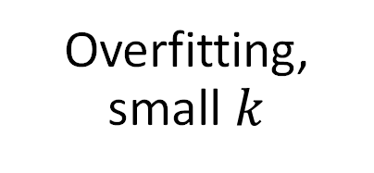
Weakness of KNN
Overfitting, small $k$
Sensitive to outliers
Memory
Notes:
Makes no assumption about the data generating process, which can lead to overfitting without sufficient training observations or too small a kvalue.
The data set must be stored where the model can access it, which can use up a large amount of memory with large data sets.
Making predictions is relatively slow compared to parametric models because it needs to compute the distances to the training data points, sort them, retrieve the k closest points, and then make a prediction.
K-NN is a victim of the curse of dimensionality; it does not perform well with high dimensions where data points become very spread out.
K-NN has difficulty with observations spread out in the feature space.
K-NN is sensitive to outliers.

Slide 14
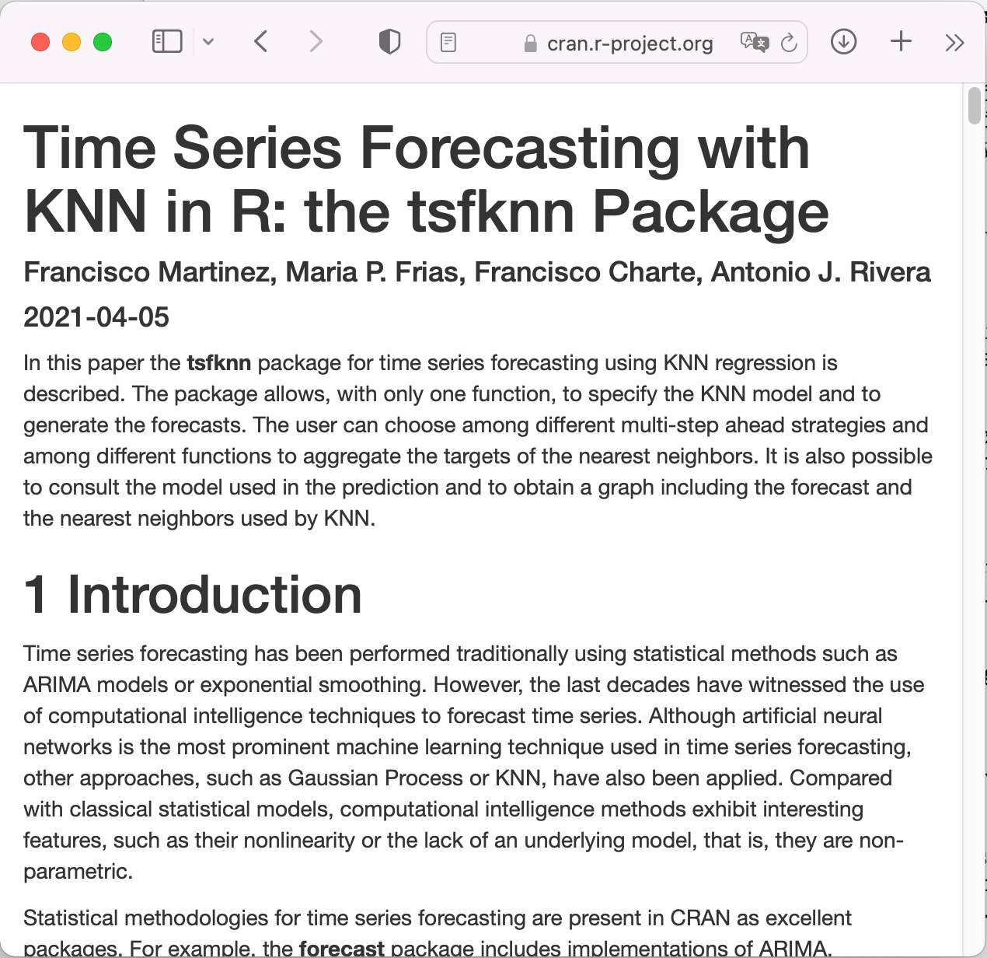
Implementation

Slide 15
How does KNN regression work?
By setting a K. At the point that where we want to predict, we take the K nearest points and then take the average of their values.
The k-nearest points corresponds to the last k points in the training data.

Slide 16
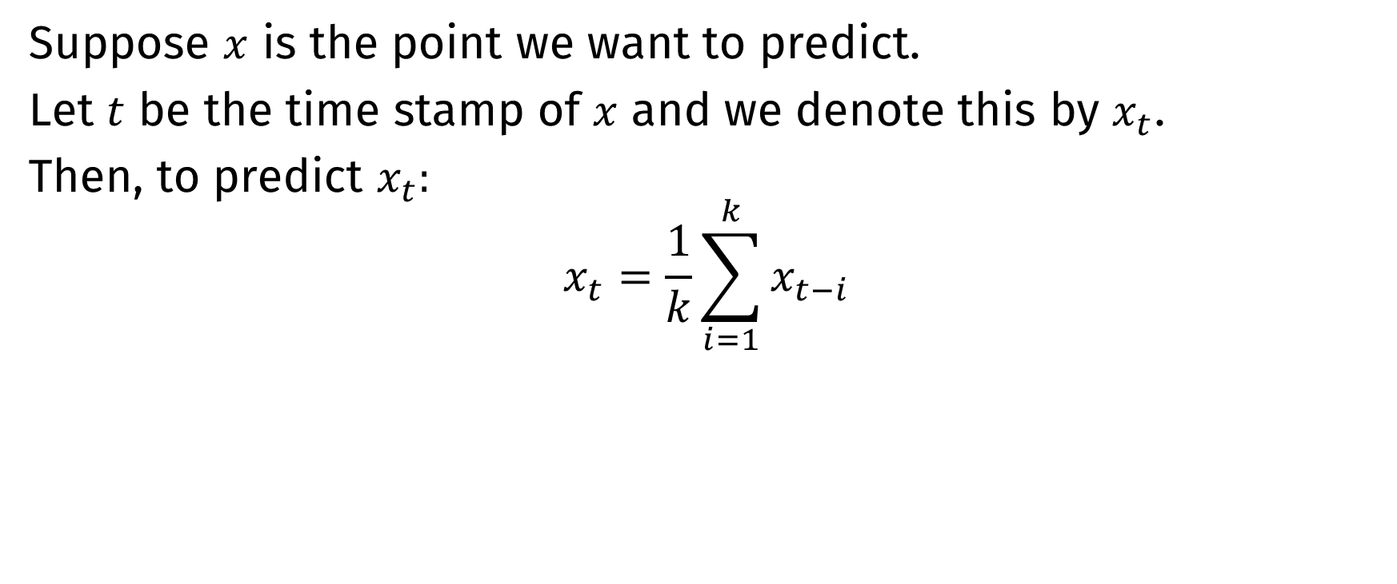
How does KNN regression work?
Suppose $x$ is the point we want to predict.
Let $t$ be the time stamp of $x$ and we denote this by $x_{t}$.
Then, to predict $x_{t}:$
$$x_{t}=\frac{1}{k}\sum_{i=1}^{k}{x_{t−i}}$$

Slide 17
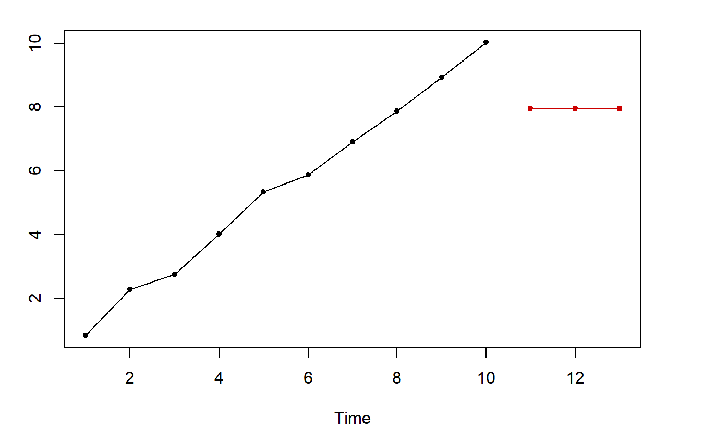
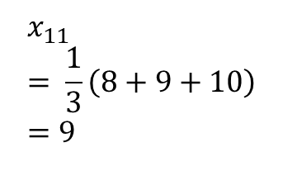
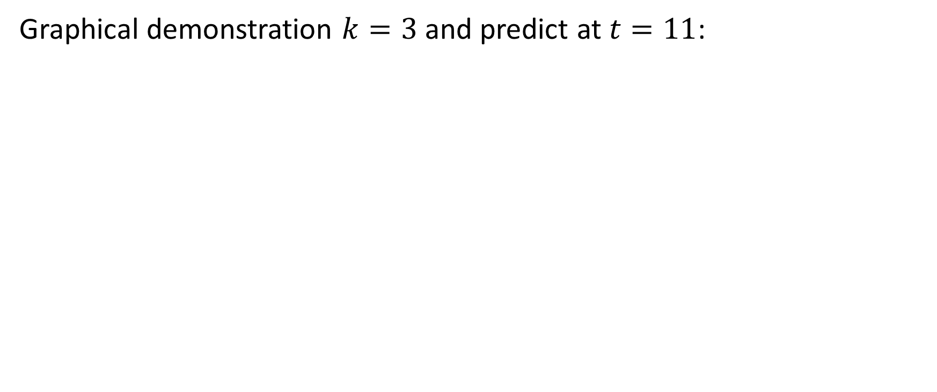

How does KNN regression work?
Graphical demonstration $k=3$ and predict at $t=11$:
$$x_{11}= \frac{1}{3}\left(8+9+10\right) \\ =9$$

Slide 18
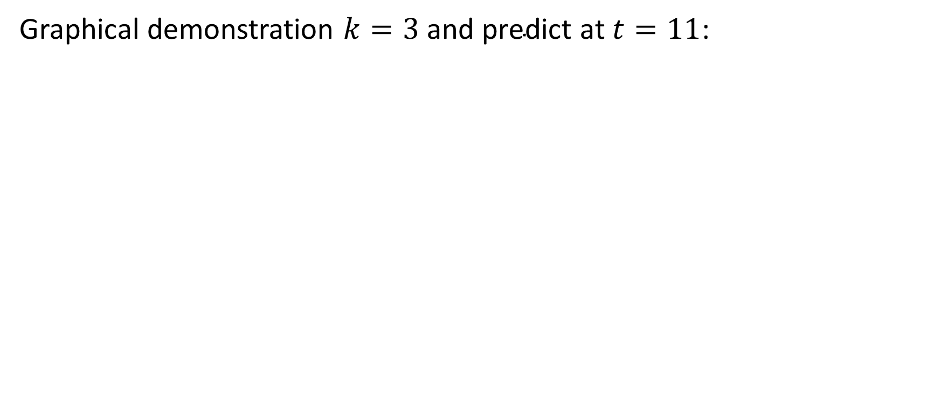
How does KNN regression work?
Graphical demonstration $k=3 \text{and} \text{predict} \text{at} t=11$:

Slide 19
How does KNN regression work?
Extrapolate the results for the rest of the test time frame:

Slide 20
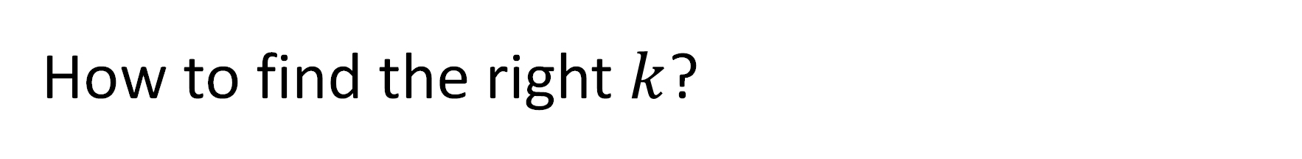
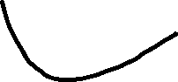
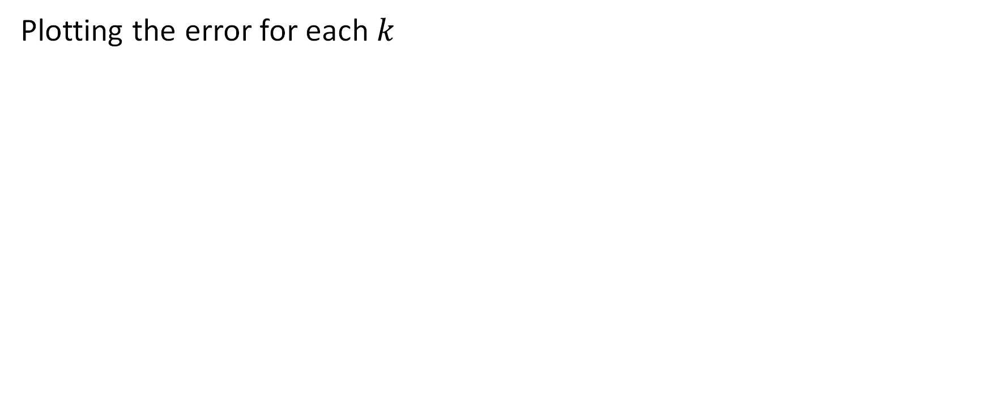

How to find the right $k$?
Plotting the error for each $k$
Notes:
For a very low value of k (suppose k=1), the model overfits on the training data, which leads to a high error rate on the validation set. On the other hand, for a high value of k, the model performs poorly on both train and validation set. If you observe closely, the validation error curve reaches a minima at a value of k = 9. This value of k is the optimum value of the model (it will vary for different datasets). This curve is known as an ‘elbow curve‘ (because it has a shape like an elbow) and is usually used to determine the k value.
https://www.analyticsvidhya.com/blog/2018/08/k-nearest-neighbor-introduction-regression-python/

Slide 21
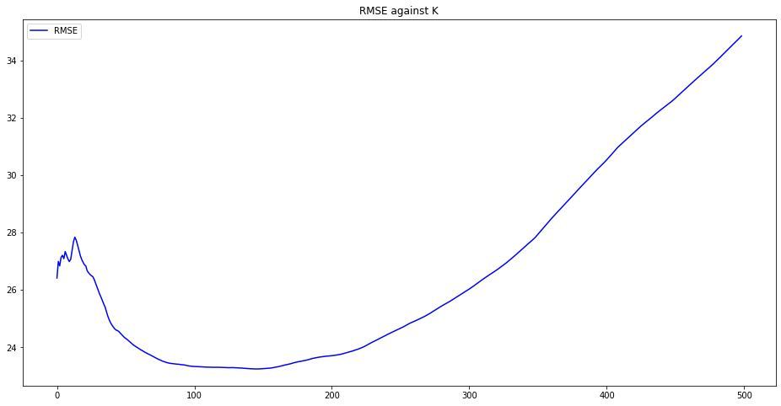
How to find the right $k$?
For example, in the 5-year period dataset,
RMSE
Notes:
For a very low value of k (suppose k=1), the model overfits on the training data, which leads to a high error rate on the validation set. On the other hand, for a high value of k, the model performs poorly on both train and validation set. If you observe closely, the validation error curve reaches a minima at a value of k = 9. This value of k is the optimum value of the model (it will vary for different datasets). This curve is known as an ‘elbow curve‘ (because it has a shape like an elbow) and is usually used to determine the k value.
https://www.analyticsvidhya.com/blog/2018/08/k-nearest-neighbor-introduction-regression-python/

Slide 22
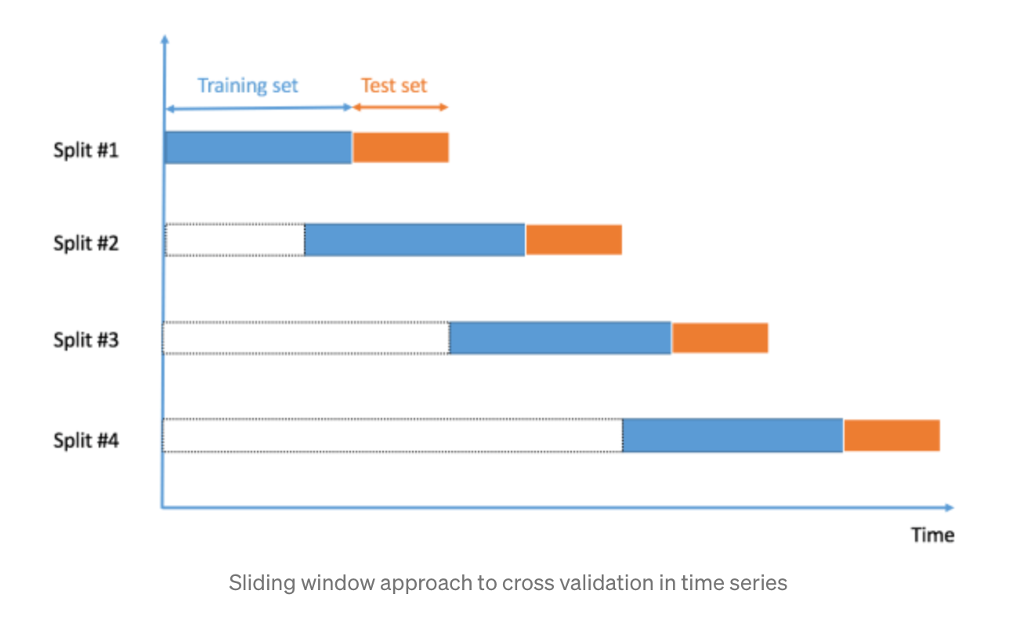
Validating using a rolling window
Notes:
https://towardsdatascience.com/predicting-future-stock-market-trends-with-python-machine-learning-2bf3f1633b3c

Slide 23
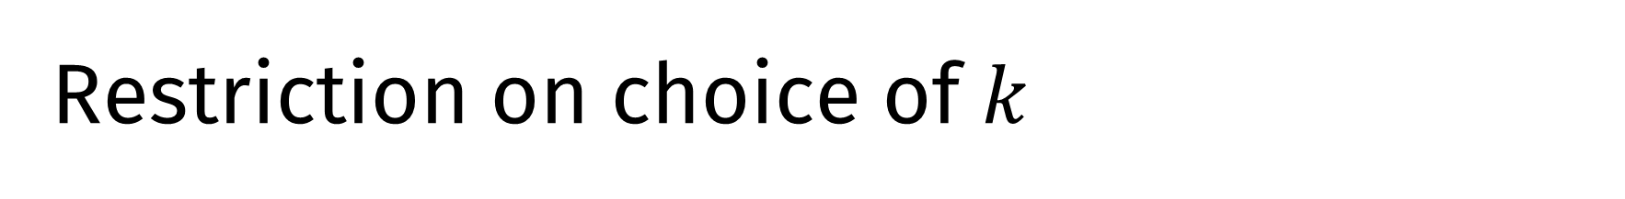
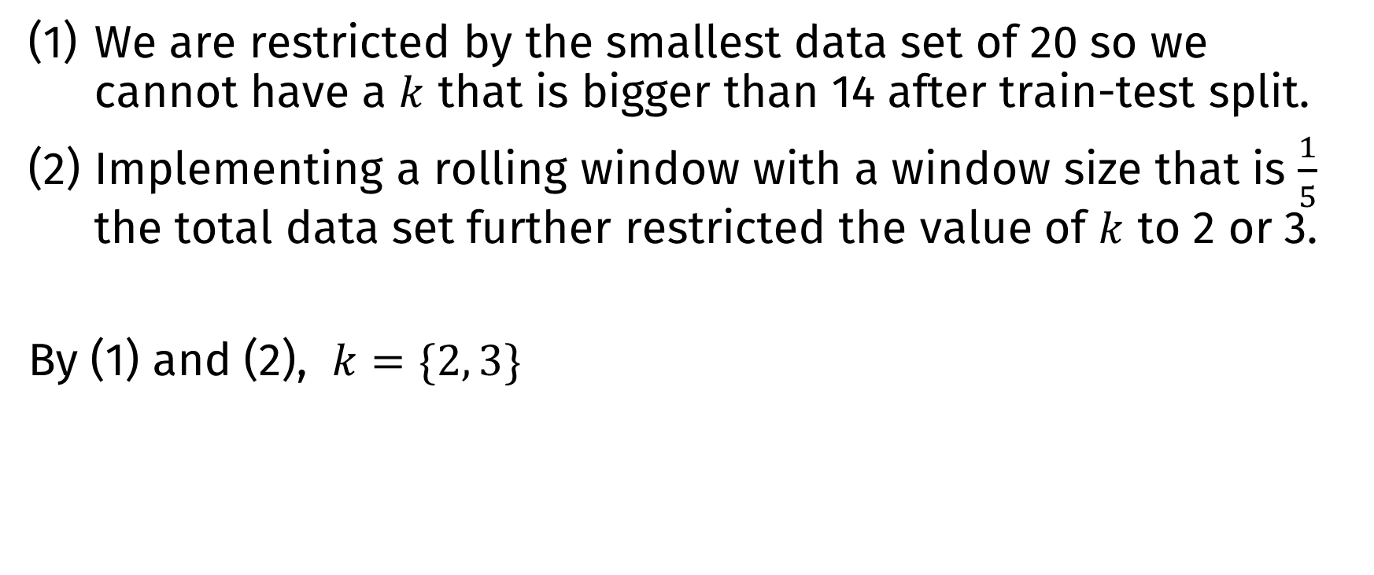
Restriction on choice of $k$
We are restricted by the smallest data set of 20 so we cannot have a $k$ that is bigger than 14 after train-test split.
Implementing a rolling window with a window size that is $\frac{1}{5}$ the total data set further restricted the value of $k$ to 2 or 3.
By (1) and (2), $k=\{2, 3\}$
Notes:
For a very low value of k (suppose k=1), the model overfits on the training data, which leads to a high error rate on the validation set. On the other hand, for a high value of k, the model performs poorly on both train and validation set. If you observe closely, the validation error curve reaches a minima at a value of k = 9. This value of k is the optimum value of the model (it will vary for different datasets). This curve is known as an ‘elbow curve‘ (because it has a shape like an elbow) and is usually used to determine the k value.
https://www.analyticsvidhya.com/blog/2018/08/k-nearest-neighbor-introduction-regression-python/

Slide 24
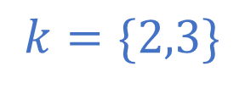
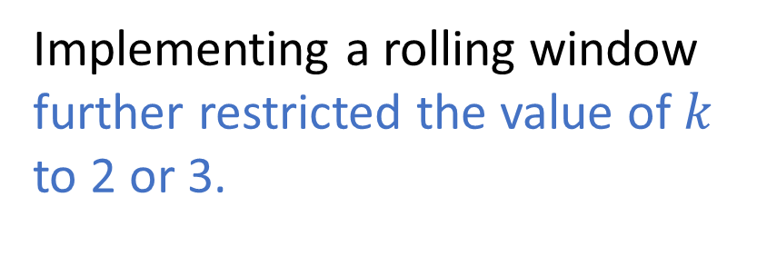
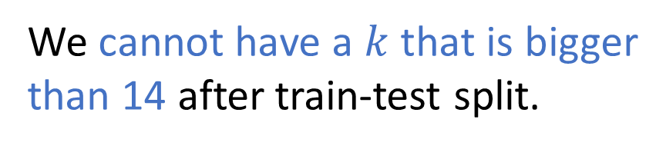
Restriction on choice of $k$
We cannot have a $k$ that is bigger than 14 after train-test split.
1
2
$$k=\{2,3\}$$
Implementing a rolling window further restricted the value of $k$ to 2 or 3.
Notes:
For a very low value of k (suppose k=1), the model overfits on the training data, which leads to a high error rate on the validation set. On the other hand, for a high value of k, the model performs poorly on both train and validation set. If you observe closely, the validation error curve reaches a minima at a value of k = 9. This value of k is the optimum value of the model (it will vary for different datasets). This curve is known as an ‘elbow curve‘ (because it has a shape like an elbow) and is usually used to determine the k value.
https://www.analyticsvidhya.com/blog/2018/08/k-nearest-neighbor-introduction-regression-python/

Slide 25
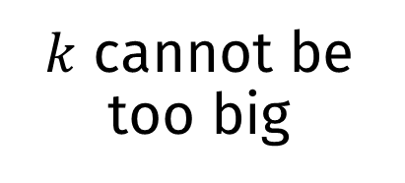
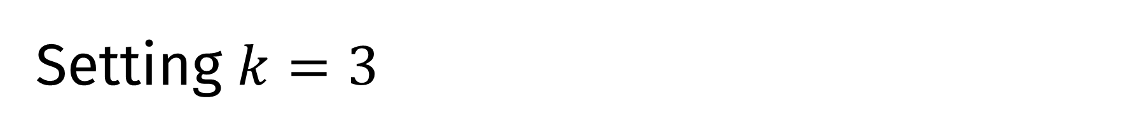
Setting $k=3$
Variance-bias Tradeoff
$k$ cannot be too big
Rolling Window

Slide 26
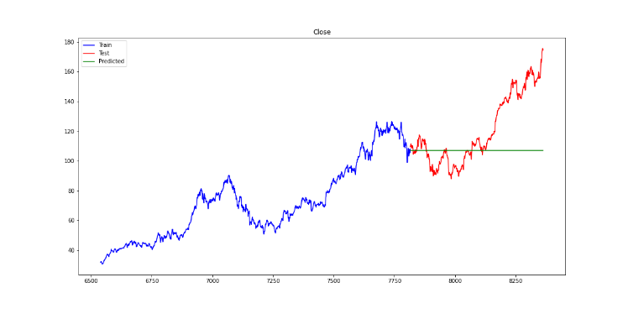
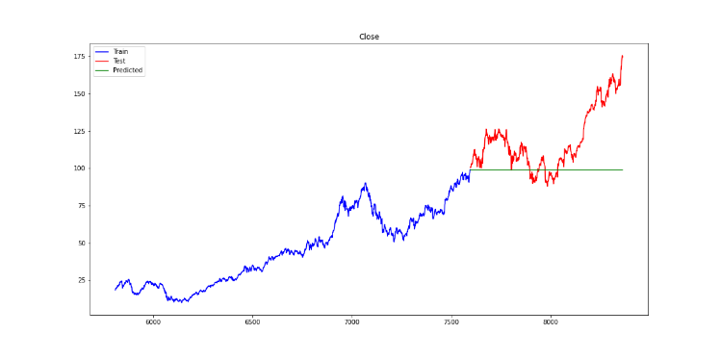
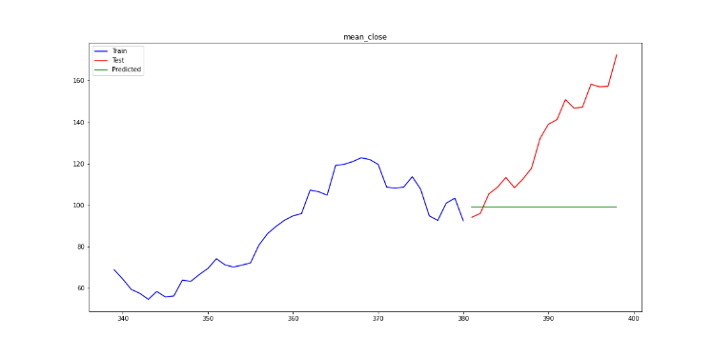
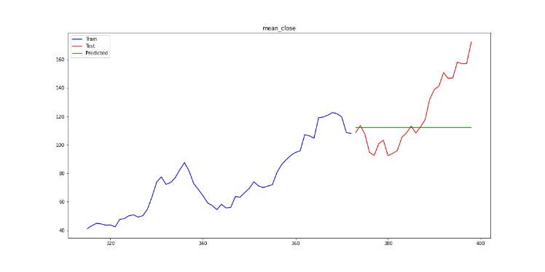
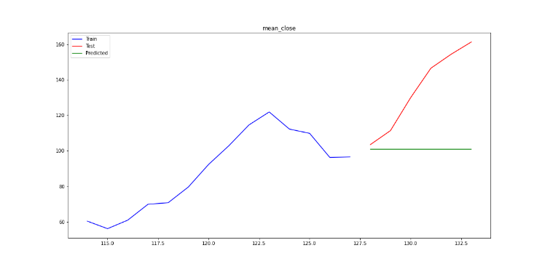
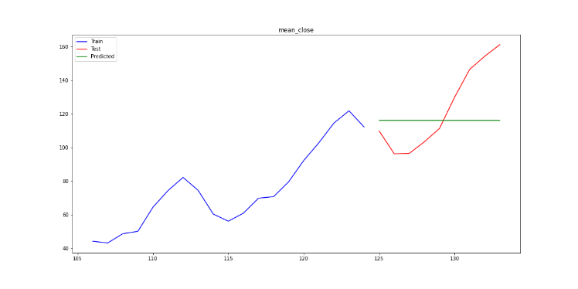
Results
Train
Test
5-year
7-year
Predicted
Day
Month
Quarterly

Slide 27
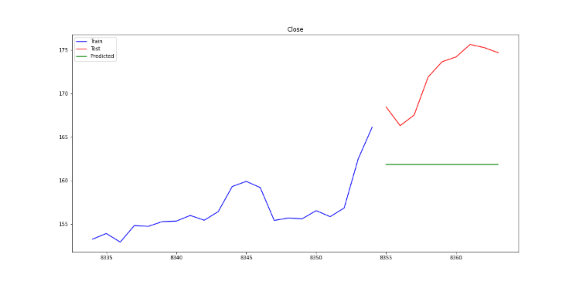
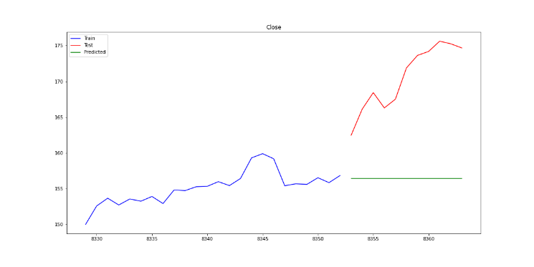
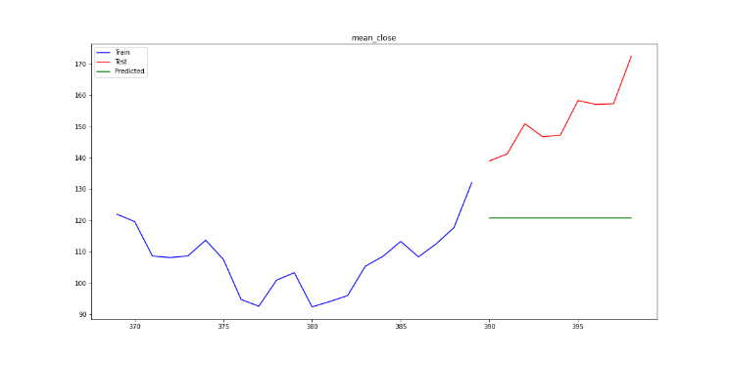
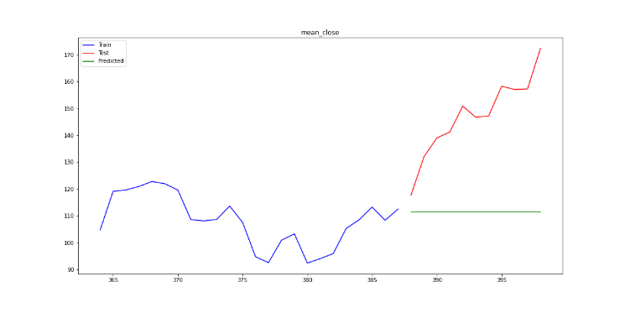
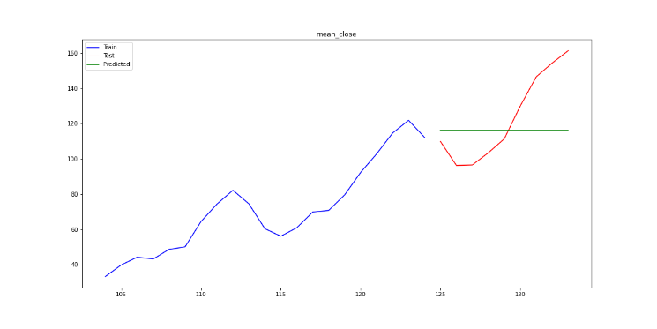
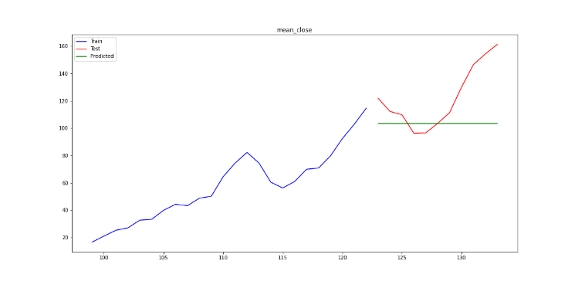
Results
Train
Test
30-points
35-points
Predicted
Day
Month
Quarterly

Slide 28
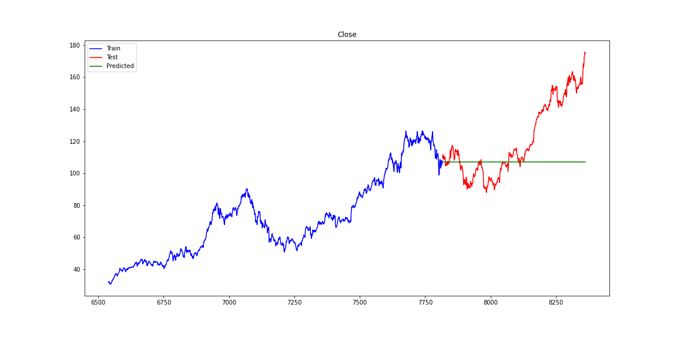
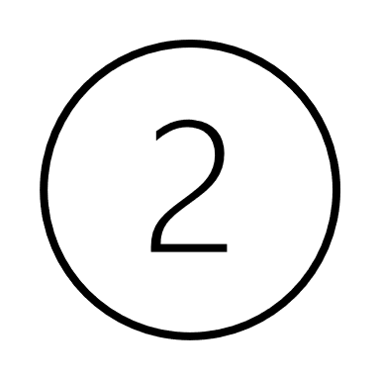
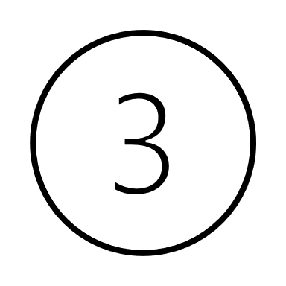

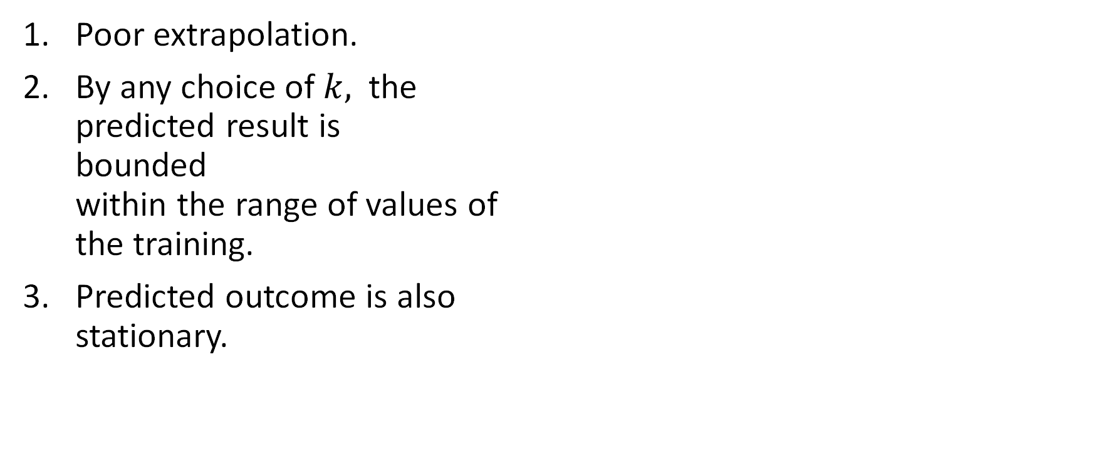
Observations
Train
Poor extrapolation.
By any choice of $k,$ the predicted result is bounded within the range of values of the training.
Predicted outcome is also stationary.
Test
Predicted
Notes:
This is expected as KNN does may not perform well in extrapolating results but more suitable for interpolating.

Slide 29
Performance (RMSE)

Slide 30
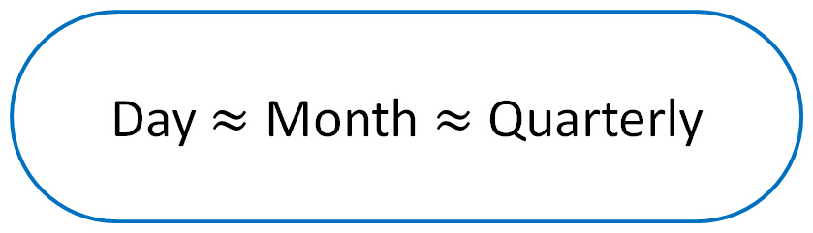
Performance (RMSE)
Day $≈$ Month $≈$ Quarterly

Slide 31
Performance (RMSE)
Day < Quarter < Month

Slide 32
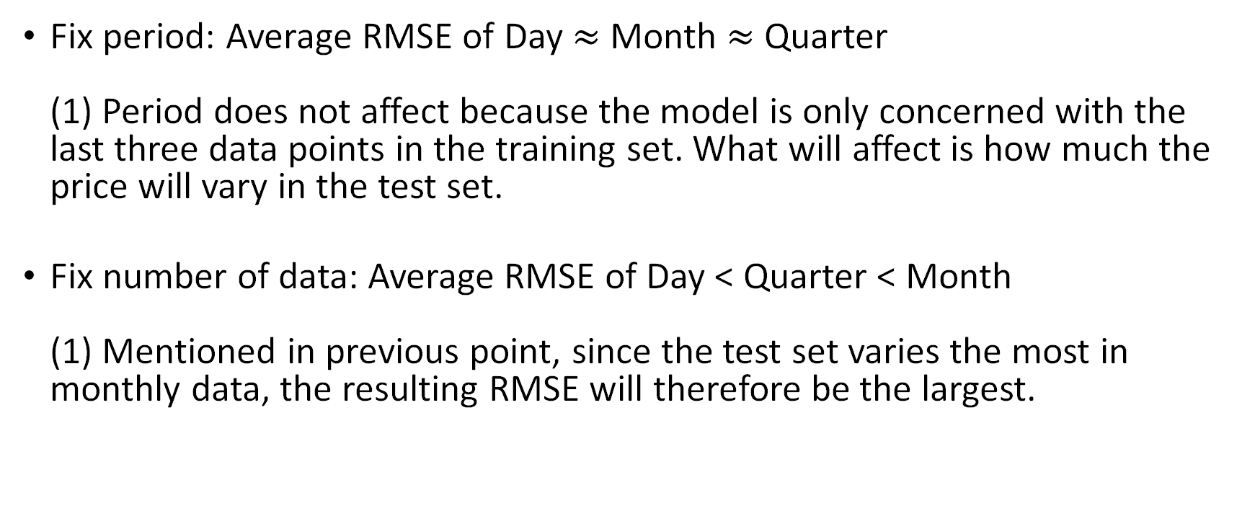
Performance (RMSE)
Fix period: Average RMSE of Day $≈$ Month $≈$Quarter (1) Period does not affect because the model is only concerned with the last three data points in the training set. What will affect is how much the price will vary in the test set.
Fix number of data: Average RMSE of Day < Quarter < Month (1) Mentioned in previous point, since the test set varies the most in monthly data, the resulting RMSE will therefore be the largest.
Notes:
(1) The range (max – min) of prices for dataset in Quarter > Month > Day, Quarterly data is predicting more and for a larger range. Since quarterly data would increase more than Month and Day, their corresponding RMSE would be bigger for Quarter then followed by Month and Day.

Slide 33
Performance (RMSE)
Fix period: Average RMSE of Day $≈$ Month $≈$Quarter
Fix number of data: Average RMSE of Day < Quarter < Month
Notes:
(1) The range (max – min) of prices for dataset in Quarter > Month > Day, Quarterly data is predicting more and for a larger range. Since quarterly data would increase more than Month and Day, their corresponding RMSE would be bigger for Quarter then followed by Month and Day.

Slide 34
Possible improvements
Assigning different weights to calculate the average.
Additive and multiplicative effects.

Slide 35
Limitations
Model is very simple to understand but KNN is not suitable for extrapolating graph predictions.
The longer we want to project into the future, the poorer the predictions.

Slide 36
Limitations
Model is very simple to understand but KNN is not suitable for extrapolating graph predictions.
The longer we want to project into the future, the poorer the predictions.

Slide 37
Next up…
We will see how a more complex model can overpower our naïve KNN model for regression.

Slide 38
ARIMA
Quite simple and Better performing

Slide 39
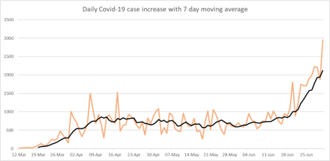
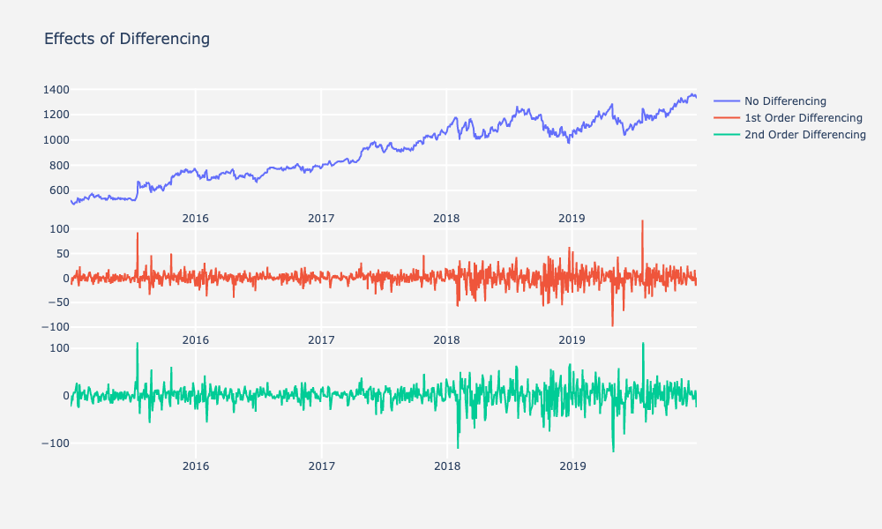
Why ARIMA?
Caters to the characteristics of time series data:
1) Trend – by using moving average
2) Stationarity – through differencing of raw observations
Notes:
https://www.mastersindatascience.org/learning/what-is-arima-modeling/
Flexible enough to capture some of the trend and relationships of the data.
Simple enough to not overfit

Slide 40
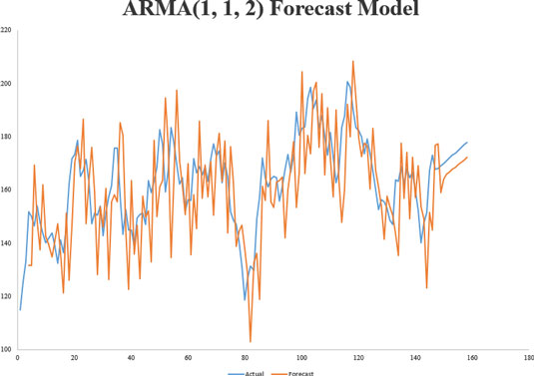
What is ARIMA?
ARIMA is a univariate time series model that uses the previous values of the time series to predict future values.
Notes:
https://www.mastersindatascience.org/learning/what-is-arima-modeling/
Flexible enough to capture some of the trend and relationships of the data.
Simple enough to not overfit

Slide 41
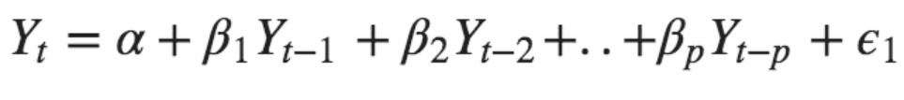
What does ARIMA=AR+I+MA stand for?
Auto Regressive – forecasts variable using a linear combination of past values of the variable
$$Y_{t}=α+β_{1}Y_{t−1}+β_{2}Y_{t−2}+⋯+β_{p}Y_{t−p}+ε_{1}$$
Value of Y at time t

Slide 42
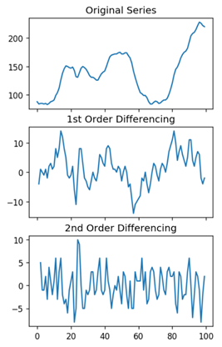
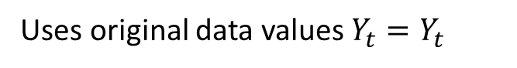


What does ARIMA=AR+I+MA stand for?
Integrated – Differencing of raw observations for stationarity
Uses original data values $Y_{t}=Y_{t}$
Replaces original data values $Y_{t}$ with
$$Y_{t^{′}}=Y_{t}−Y_{t−1}$$
Replaces original data values $Y_{t}$ with
$$Y_{t^{′′}}=Y_{t^{′}}−Y_{t^{′}−1}$$

Slide 43


What does ARIMA=AR+I+MA stand for?
Moving Average – predicts variable using lagged forecast errors of the autoregression model
$$Y_{t}=α+ε_{t}+φ_{1}ε_{t−1}+φ_{2}ε_{t−2}+⋯+φ_{q}ε_{t−q}$$
Error term at time t comes from the autoregression model below
$$Y_{t}=β_{1}Y_{t−1}+β_{2}Y_{t−2}+⋯+β_{0}Y_{0}+ε_{t}$$

Slide 44






Imagine ARIMA as a model built with smaller models like Lego blocks.
AR model we denote this with p.
I we denote with d.
MA model we denote with q.
Combining them we get ARIMA: ARIMA$(p, d, q)$
$$p$$
$$d$$
$$p, d, q∈ℤ_{≥0}$$
$$q$$

Slide 45
ARIMA(p, d, q)
p – number of lagged values the variable depends on
d – degree of differencing required for stationarity
q – number of residual errors the variable depends on

Slide 46
S-ARIMA(p, d, q)(P, D, Q)m
Seasonal ARIMA is used for seasonal data i.e. time series with a repeating cycle
p, d, q – same as ARIMA
P, D, Q – seasonal counterparts of p, d, q
m – number of time steps for a seasonal period, e.g. m = 12 for monthly data
​

Slide 47
S-ARIMA(p, d, q)(P, D, Q)m
Seasonal ARIMA used for seasonal data(time series with repeating cycle)
Seasonal counterparts of basic ARIMA p, d, q.
Parameter m: Number of time steps for a seasonal period
E.g. 7 for daily, 12 for monthly, 4 for quarterly
Optimal model devolves into basic ARIMA for some cases when P, D, Q are evaluated as 0.

Slide 48
To build a higher performing model like ARIMA, we need to ask ourselves:
Is the time series stationary?
Is there seasonality?
Is there autocorrelation?
These questions will determine how we build our model ARIMA model.

Slide 49


1. Stationarity
A time series is said to be stationary if its statistical properties do not change over time.
$$⟺$$
It has constant mean and variance, and covariance is independent of time.
Notes:
https://towardsdatascience.com/the-complete-guide-to-time-series-analysis-and-forecasting-70d476bfe775

Slide 50
1. Stationarity
Stationary when mean, variance and autocorrelation of variables constant over time.
Apply augmented Dickey-Fuller (ADF) test to check for stationarity.
If the test reveals that the data is not stationary then we need to do differencing, which makes data stationary.
Notes:
https://towardsdatascience.com/the-complete-guide-to-time-series-analysis-and-forecasting-70d476bfe775

Slide 51

2. Seasonality
Decompose the data using seasonal_decompose in sklearn
The raw data
This indicates strong trend (not stationary)
Not much seasonality
Leftover after subtracting trend and seasonality
Notes:
Data is on daily 5-year

Slide 52
3. Autocorrelation
Informally, autocorrelation is the similarity between observations as a function of the time lag between them.
This is done by analysing the Autocorrelation function (ACF) and Partial Autocorrelation Function (PACF), we can understand the autocorrelations at each lag.
Notes:
https://towardsdatascience.com/the-complete-guide-to-time-series-analysis-and-forecasting-70d476bfe775

Slide 53
Auto-ARIMA
auto_arima function from pmdarima library to generate optimal hyperparameters.
Evaluate ARIMA with optimal hyperparameters for each experiment data set.

Slide 54
Implementation
Fully separate training and prediction.
Produce predictions without modifications.
Prediction
ARIMA
Training Set
Prediction Set
Test Set
Actual Label

Slide 55
Implementations
Step-wise update with actual test data points.
After each prediction, add the predicted point's corresponding test label to the model.
Prediction
ARIMA
Training Set
Prediction Set
Test Set
Actual Label
Add label corresponding to current prediction at each step

Slide 56
Implementations
Dynamic update with new predictions at each step.
After each prediction, add the latest prediction to the model.
Add newest prediction back to model
Prediction
ARIMA
Training Set
Prediction Set
Test Set
Actual Label

Slide 57
Performance of Implementations (RMSE)
Updating with test data at each step always best performance.
Data snooping!
Impractical for forecasting as need actual labels beforehand.
Prediction
ARIMA
Training Set
Prediction Set
Test Set
Actual Label
Add label corresponding to current prediction at each step

Slide 58
Performance of Implementation (RMSE)
Dynamic updating with each new prediction.
Less accurate than unmodified ARIMA.
Add newest prediction back to model
Prediction
ARIMA
Training Set
Prediction Set
Test Set
Actual Label

Slide 59
Performance of Implementation (RMSE)
Other methods less accurate, much more computationally intensive, problems like data snooping.
We use unmodified ARIMA's results.
Prediction
ARIMA
Training Set
Prediction Set
Test Set
Actual Label

Slide 60






Results
Train
5-year
7-year
Test
Predicted
Daily
Monthly
Quarterly

Slide 61






Results
Train
30 points
35 points
Test
Predicted
Daily
Monthly
Quarterly

Slide 62

Performance (RMSE)

Slide 63
ARIMA Performance Analysis
Training set best size and period selection criteria inconclusive.
Comparing RMSE with different number of data points:
7 years < 5 years
30 points < 35 points
Fixed points average < Fixed period average, except for monthly.

Slide 64
ARIMA Performance Analysis
Actual stock close value has increasing trend over time.
If training trend majority increasing, can predict increasing trend.
Big decreases in training data cause inaccurate predicted patterns of increasing or decreasing trend.

Slide 65
ARIMA Performance Analysis
Daily predictions always fit the closest leading to lowest RMSE.
RMSE is highest for monthly predictions.
Smoother prediction plot, higher RMSE: "jagged" portions that are closer to true values are wiped out.
Why is quarterly lower than monthly?
Fixed period: Much fewer data points contributing to error than monthly.
Fixed points: Inaccurate decreasing trend for monthly.

Slide 66
ARIMA Limitations
Data points have to be stationary.
Needs sufficient data points, otherwise model breaks down.
Susceptible to fluctuations in training data points.

Slide 67
LSTM (Long Short-Term Memory)
Not so simple but high performing

Slide 68

Motivation for LSTM
LSTM is based on Recurrent Neural Networks (RNN)
Maintains memory, suitable for time series forecasting
Notes:
So why did we choose to implement LSTM instead of the traditional RNN?
As we have learnt, recurrent neural networks face the vanishing gradient problem causing short term dependency problem in RNN where weight updates ignore information earlier back in time. In addition, they also face the exploding gradient problem, where gradient becomes too big the more backpropagation we do → resulting in large weight updates, causing gradient descent to diverge.
These problems prevent RNN from dealing with complex sequences, since we cannot optimize gradient through backpropagation in a meaningful way

Slide 69
Motivation for LSTM
Why not traditional RNN?
How LSTM solves the problem
Vanishing gradient 0.9^100 = 0.0002656.... ​
Short term memory dependency :(
LSTM uses additional gates on top of the traditional RNN​
Notes:
So why did we choose to implement LSTM instead of the traditional RNN?
As we have learnt, recurrent neural networks face the vanishing gradient problem causing short term dependency problem in RNN where weight updates ignore information earlier back in time. In addition, they also face the exploding gradient problem, where gradient becomes too big the more backpropagation we do → resulting in large weight updates, causing gradient descent to diverge.
These problems prevent RNN from dealing with complex sequences, since we cannot optimize gradient through backpropagation in a meaningful way

Slide 70

Gates
- Gates
Forget gate
Decide relevancy of the information passing through
(forget gate – sigmoid function to modulate information between 0 to 1)
Passed error close to value of 1
Hence, mitigate vanishing gradient problem.

Slide 71

How does LSTM mitigate gradient problems?
Forget gate
Decides what information is relevant
Sigmoid function used
Data closer to 0 [forget], closer to 1 [keep]
Notes:
Main idea on how LSTM curb this problem is through the use of a forget gate.
This gate helps the current layer decide on which information is relevant. By running the information through a sigmoid function, values close to 0 could be forgotten and values closer to 1 will be retained.
This extracts important component of the information passed and will be updated in the cell state later on, before it is passed onto the next hidden layer.
Since only values closer to 1 are retained, the problems of vanishing or exploding gradient are mitigated.
//could probably explain more high level details of forget gate

Slide 72

LSTM Parameters
Number of neurons
Number of hidden layers
Number of output neurons
Number of epochs = 100
Batch size = 1
Dropout rate = 0.2
- mitigate overfitting
Optimizer = ADAM
- stochastic gradient descent
Notes:
Then, we create the LSTM model by selecting the following parameters. We kept the values that we chose for each parameter constant throughout the experiments, so that they will not affect our comparison of results between experiments. As with any neural network, we specify the basic parameters which are the number of neurons, hidden layers, output neurons, epochs and batch size for batch processing. TODO: explain epoch and batch size
More significantly, as we learnt that deep neural networks can be prone to overfitting due to too many parameters. So in order to mitigate overfitting we also added dropout rate into our LSTM model. This would randomly drop out neurons during batch training such that during the training phase, these neurons cannot be propagated through, to lessen picking up of noise or nuances of the training data.
In addition, we use ADAM to optimize our model. This is actually an extension of stochastic gradient descent, to update the weights iteratively based on training data.
Now, that our model is specified and trained on timestepped data, lets move on to see the results we got.

Slide 73

Timestep
We create a time-stepped dataset with timestep = 3.
Learn from 3 timesteps to predict the next timestep
Notes:
TODO: Explain what is timestep. LSTM uses the sliding time window technique mentioned in lectures, which is the use of prior timesteps to predict the next timestep. For our model, we use 3 timesteps to predict the next timestep, which means that we take 3 latest data points into consideration in predicting a future value. As shown on the diagram, the LSTM model is learning from the data, from the 3 timesteps which are allocated to the left side of the red centered line within the rolling window, to predict the data which is located to the right of this new red vertical line within the new rolling window.
Motivation -> how it works -> parameters/hyperparameters ->predict/results -> evaluation from results -> limitations

Slide 74






Results
Train
7-year
Test
5-year
Predicted
Day
Month
Quarter
Notes:
Now, we are showing our prediction results for fixed period of 5 years and 7 years. Remember, this means we have most datapoints for daily dataset and least for quarterly dataset. Visually speaking, we can see that for daily data, the green prediction line fits to the red test line almost identically. This indicates that the model has learnt daily data well and gives a very good prediction curve. This is not so much the case for quarterly dataset as we can see the biggest divergence between the green prediction lines and red testing lines.
So only based on these graphs, we can visually say that the model predicts most accurately for daily dataset. Lets now move on to the prediction results for datasets with fixed number of instances.

Slide 75






Results
Train
Test
30-points
35-points
Predicted
Day
Month
Quarter
Notes:
So the previous phenomenon we saw was that the daily prediction line fit very closely to the red testing line, unlike quarterly data.
Now, that the number of data points are fixed for all 3 seasonalities, comparing the graphs, we don’t see much differences between them, in terms of how all their green prediction lines fit with the red testing lines.
Thus, the difference in accuracy we saw earlier may be due to the fact that daily had much more datapoints that quarterly data.
Since, we cant really make any concrete conclusions just visually based on the graph of predictions, lets look into evaluation metrics to find out more.

Slide 76
Evaluation from our results

Slide 77
Reasons for trend – Fixed time period
5 years
Number of instances
1825
Less Overfitting → generalize better
Lower Variance
Daily
60
Monthly
More Overfitting
Higher Variance
20
Quarterly

Slide 78
Reasons for trend – Fixed data points
30 instances
Further lookback
Less relevant
Larger price range (min-max)
Smaller lookback
More relevant
Smaller price range
Daily [30 days]
Time
Monthly [2.5 years]
Quarterly [7.5 years]

Slide 79
Reasons for trend – Fixed data points
35 instances

Slide 80
Conclusion for LSTM
Revisiting the Problem statement:
What is the best/most accurate timeframe to apply Machine Learning predictions for the stock market?
Or is it…?
Daily
Monthly
Quarterly

Slide 81
Final evaluations

Slide 82
Macroscopic analysis
Given equal absolute value of RMSE:
Quarterly
Monthly
Daily
Level of Erroneous Effect

Slide 83
Macroscopic analysis
 | Daily | Monthly | Quarterly
RMSE (Fixed time period) | 2.38 | 10.68 | 18.89
RMSE (Fixed instances) | 3.60 | 10.23 | 20.29
Average RMSE | 2.99 | 10.455 | 19.59
Days | 1 | 30 | 120
Average RMSE per day | 2.99 | 0.35 | 0.16
$Average RMSE$= $\frac{RMSE \left(fixed time period\right) + RMSE(fixed instances)}{2}$
$Average RMSE per day$ = $\frac{Average RMSE}{Days in seasonality used}$

Slide 84
Final Conclusion
Revisiting the Problem statement:
What is the best/most accurate timeframe to apply Machine Learning predictions for the stock market?
Daily
Monthly
Quarterly

Slide 85

Potential Improvements
CNN + LSTM

